Slide 1

Exploring
#7 Express REST API

Slide 2
API
API (Application Programming Interface) is a software intermediary which allows applications to talk to each other.
When you use an application on your mobile phone, the application connects to the Internet and sends data to a server. The server then retrieves that data, interprets it, performs the necessary actions and sends it back to your phone. The application then interprets that data and presents to you with the information that you wanted, in a readable way. This is what an API is - all of this happens via API.

Slide 3
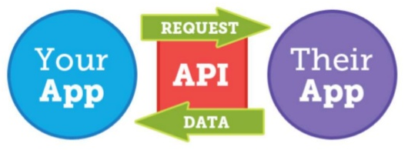
API

Slide 4
HTTP Methods
HTTP (The Hypertext Transfer Protocol) is designed to enable communications between clients & servers. It works as a request & response protocol between a client & server.
A web browser may be the client, and an application on a computer that hosts a web site may be the server.
The most commonly used HTTP Methods are POST, GET, PUT, PATCH & DELETE.

Slide 5
RESTful APIs
RESTful (Representational State Transfer) web services is a way of providing interoperability between computer system on the internet.
A RESTful API is an application program interface that uses HTTP requests to GET, PUT, POST or UPDATE data, based on representational state transfer (RESTful) architecture technology.

Slide 6
Express
Express is a minimal and flexible Node.js web application framework that provides a robust set of features for web & mobile applications.
Express provides a thin layer of fundamental web application features, without obscuring Node.js features that you know and love (See https://expressjs.com).
Installation
npm install express --save

Slide 7
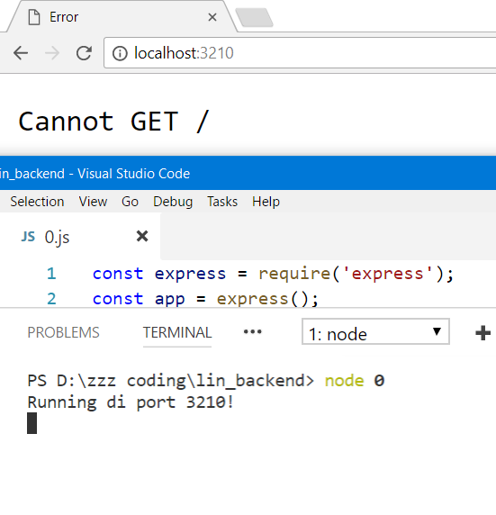
Create Server
const express = require('express');
const app = express();
app.listen(3210, function(){
console.log('Run @port 3210!');
});

Slide 8
GET Then
End Request
const express = require('express');
const app = express();
app.get('/', function(req, res){
console.log('GET request');
res.end(); //end request
});
app.listen(3210, function(){
console.log('Run @port 3210!');
});

Slide 9
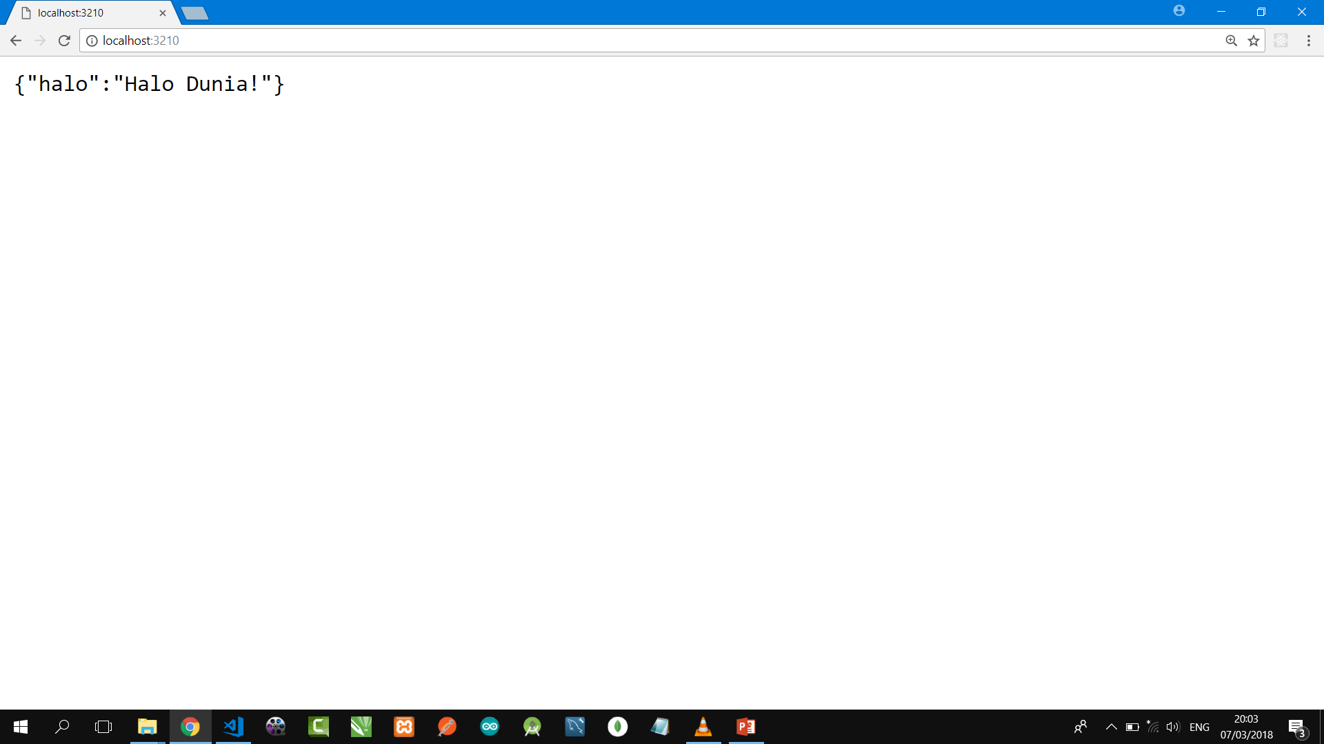
GET Then Send Response
const express = require('express');
const app = express();
app.get('/', function(req, res){
console.log('GET request');
res.send({halo:'Halo Dunia!'});
});
app.listen(3210, function(){
console.log('Run @port 3210!');
});

Slide 10
GET Then Send Response
const express = require('express');
const app = express();
app.get('/api', function(req, res){
console.log('GET request');
res.send({pesan:'Ini GET!'});
});
app.listen(3210, function(){
console.log('Run @port 3210!');
});

Slide 11
GET & POST Then
Send Response
. . . . . .
app.get('/api', function(req, res){
console.log('GET request');
res.send({pesan:'Ini GET!'});
});
app.post('/api', function(req, res){
console.log('POST request');
res.send({pesan:'Ini POST!'});
});
. . . . . .

Slide 12
PUT & DELETE Then
Send Response
. . . . . .
app.put('/api/:id', (req, res) => {
console.log('PUT request');
res.send({pesan:'Ini PUT!'});
});
app.delete('/api/:id', (req, res) => {
console.log('DELETE request');
res.send({pesan:'Ini DELETE!'});
});
. . . . . .

Slide 13

A powerful GUI platform to make API development faster & easier, from building API requests through testing, documentation & sharing.
Postman has features for every API developer: request building, tests & pre-request scripts, variables, environments & request descriptions, designed to work seamlessly together.
Download from getpostman.com

Slide 14
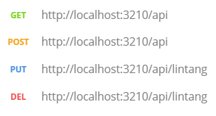
Run server at localhost:3210 then try Postman!

Slide 15
Handling POST With Body-Parser
const express = require('express');
const bodyParser = require('body-parser');
const app = express();
app.use(bodyParser.json()); app.post('/api', function(req, res){
console.log(req.body);
res.send({pesan:'Ini POST!'});
});
app.listen(3210, function(){
console.log('Running di port 3210!');
});
Run & try to POST
with Postman!

Slide 16
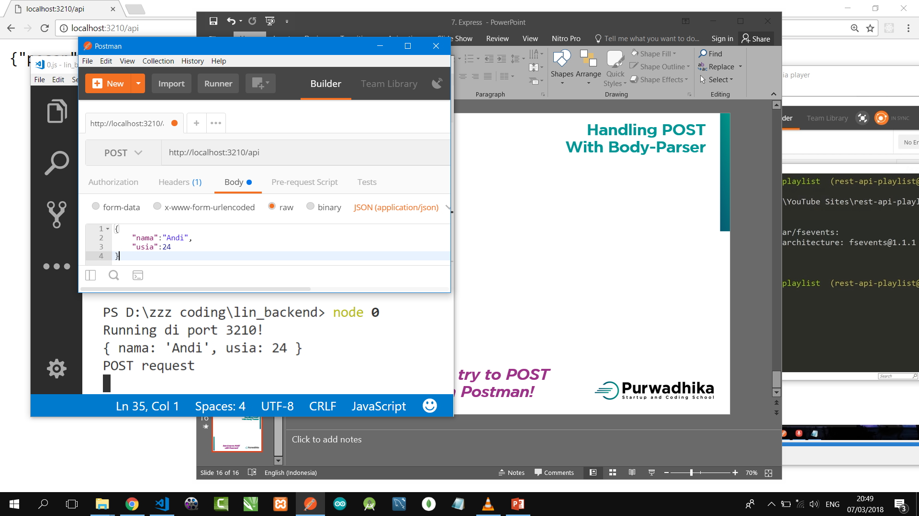
Handling POST with Body-Parser
Run server!
Set POST & url.
Set on Body:
* raw
* JSON
Fill text area
with a JSON.
Click SEND!
See on body res
& console!

Slide 17
Handling POST With Body-Parser
(Req.Body as Response)
. . . . . .
app.use(bodyParser.json()); app.post('/api', function(req, res){
console.log(req.body);
res.send({
type: 'POST',
nama: req.body.nama,
usia: req.body.usia
});
});
. . . . . .
Run & try to POST
with Postman!

Slide 18
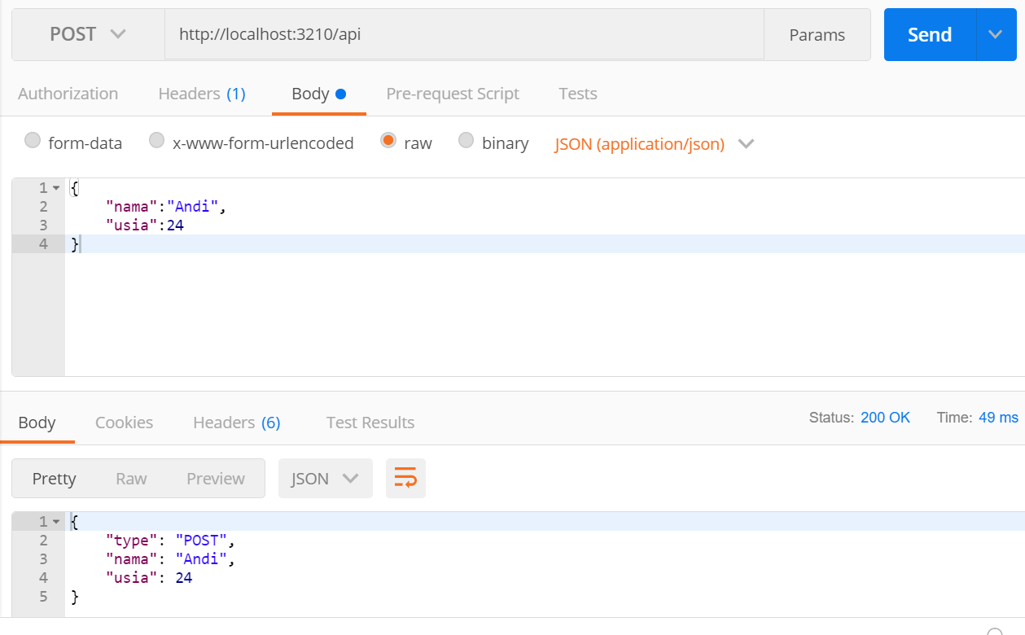
Handling POST with Body-Parser
(Req.Body as Response)
Body Req
Body Res

Slide 19
Handling
404 Not Found
. . . . . .
app.use((req, res, next) => {
res.status(404)
.send("404 Not Found")
})
app.listen(3000)
. . . . . .
Insert below all routes!
On top server activation.

Slide 20

Express Router
/beranda
/profil
/berita
/galeri
/tentang
/kontak

Slide 21
Express Router
#1 routes/route.js
const router = require('express').Router();
router.get('/satu', function(req,res) {
res.send('Ini Halaman Satu!')
})
router.get('/dua', function(req,res) {
res.send('Welcome to 2nd Page!')
})
router.get('/tiga', function(req,res) {
res.send('Ultraman Tiga!')
})
module.exports = router;

Slide 22
Express Router
#2 App.js
const express = require('express');
const lin_routes = require('./routes/route')
const app = express();
app.use(lin_routes);
app.get('/', (req,res)=>{
res.send('...Home Sweet Home...')
})
app.listen(3000, ()=>{
console.log('Server @port 3000!')
})

Slide 23
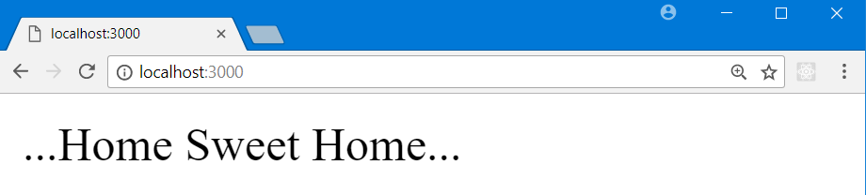
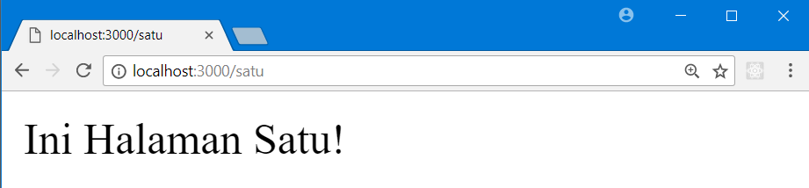


Express
Router
Results

Slide 24
Cors
Cors is a Node.js package for providing a Connect/Express middleware that can be used to enable CORS with various options.
(See npmjs.com/package/cors).
Installation
$ npm install cors --save

Slide 25
Giving Access to Everyone
Express + Cors ⬄ React
const express = require('express');
const app = express();
const cors = require('cors');
app.use(cors());
app.get('/', function(req, res){
console.log('GET request');
res.json({status:'Sukses!'});
});
app.listen(3210, function(){
console.log('Run @port 3210!');
});
Run & try to GET
From React with Axios!

Slide 26
Exploring
#7 Express REST API

